Slide 1

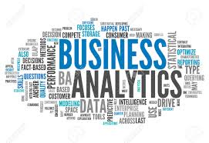
Your Partner In Digital Transformation
Corporate Presentation

Slide 2

HR Analytics
A Defour approach
Copyright © 2016 Defour Analytics Pvt. Ltd

Slide 3

Typical Challenges in HR function
Recruitment
Right Talent Acquisition
Recurring Cost
Retention
Alignment of right job profile
Gap Analysis
Motivation or Productivity
Leadership Roadmap
Training & Development
Culture

Slide 4

Difficulties in Traditional methods
Situational Based Decision making
Reactive Approach
Lack of quantitative approach
Overlooking minor details
Silos culture
MIS Reporting – Diagnostic analysis of the issue
Manual Consolidation of data for decision making – Huge Efforts

Slide 5
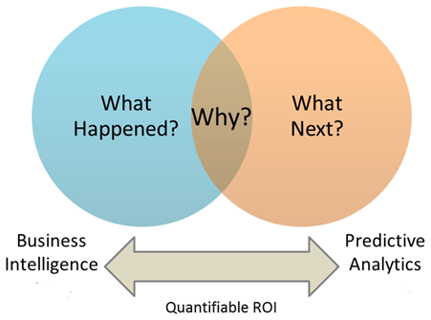
Analytical Approach to mitigate challenges
Prediction of Employee Attrition
Planned Recruitment
Job Role Change
Tracking and predicting Employee productivity
Identifying best and average performing employees
Identifying employees who require training and
development
Proactive actions to address above issues

Slide 6
Process - Flow Chart
Job Involvement
Basic Exploratory Analysis
To understand data properties
Data Collection
Calculating satisfaction level
Model Building
Decision Tress and Cluster
Data Formation
Employee Appreciation
Model Validation
Checking Accuracy
Data Preparation
Filtering ,Sorting, Variable Preparation, Assumptions
Prediction
Missing values imputation
Reference from Exit interview form
Actionable Insights

Slide 7
Use Case -Scenario - 1
Historical data of 212 employees for this organization.
From 212 employees , 89 Employees have left the organization.
Problem Statement: Organization wants to know among current employees how many employees may leave the company?
The data variables are shown below:
EMP. CODE | EMPLOYEE NAME | GENDER
AGE | QUALIFICATION | HIGHEST QUALIFICATION
DATE_OF CONFERMATION | DESIGNATION | GRADE
CURRENT CTC | WORKING STATUS | SATISFACTION LEVEL
NUMBER OF COMPAINES WORKED | PERCENT SALARY HIKE | TRAINING TIME LAST YEAR(In Hrs)
MARITAL STATUS | DATE OF BIRTH | TODAY'S DATE
EXPERIENCE OTHERS | EXPERIENCE IN ATAEIL | DATE_OF JOINING
DEPARTMENT | DIVISION | JOINING CTC
EMPLOYER APPRECIATION | JOB INVOLMENT | DISTANCE FROM HOME
YEAR SINCE LAST PROMOTION | WORKING HOURS 2017 | AVERAGE MONTHLY HOURS

Slide 8
Defour’s Analytics HR Model -Algorithm
Using Defour’s algorithm most significant variables can be found to predict the variable “Attrition”.
Adopting the advanced technique i.e. ‘Decision Tree’ model. This model predicts the attrition rate for the new 212 employees.
Advance analytical tool R is used at the back end for designing this algorithm.
Dataset has been divided into two sets of Train and test, model is built on train data and prediction and testing is done on test data.
Model performance is validated by ROC curve and area under the curve is coming out to be 96.15%
WORKFLOW for Model Building
Identifying Factors responsible for Attrition
Probability based Decision Tree Model
Advance Analytics tool
Analytics Dashboard

Slide 9
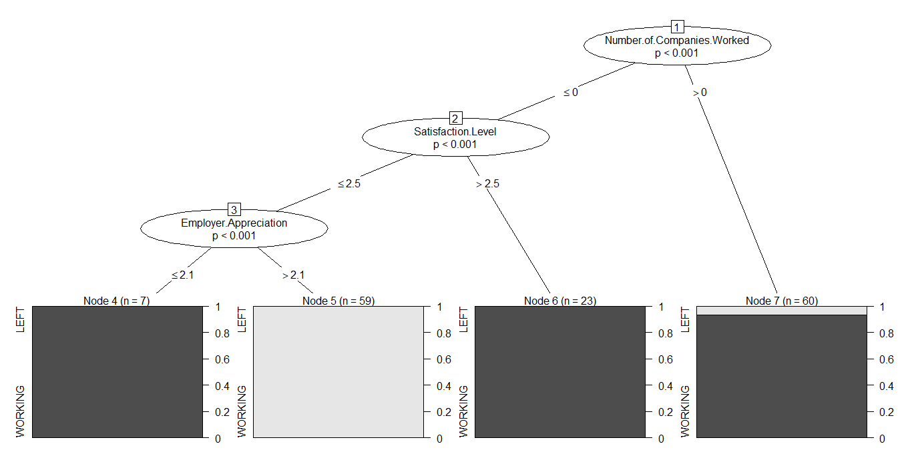
Decision Tree Output

Slide 10
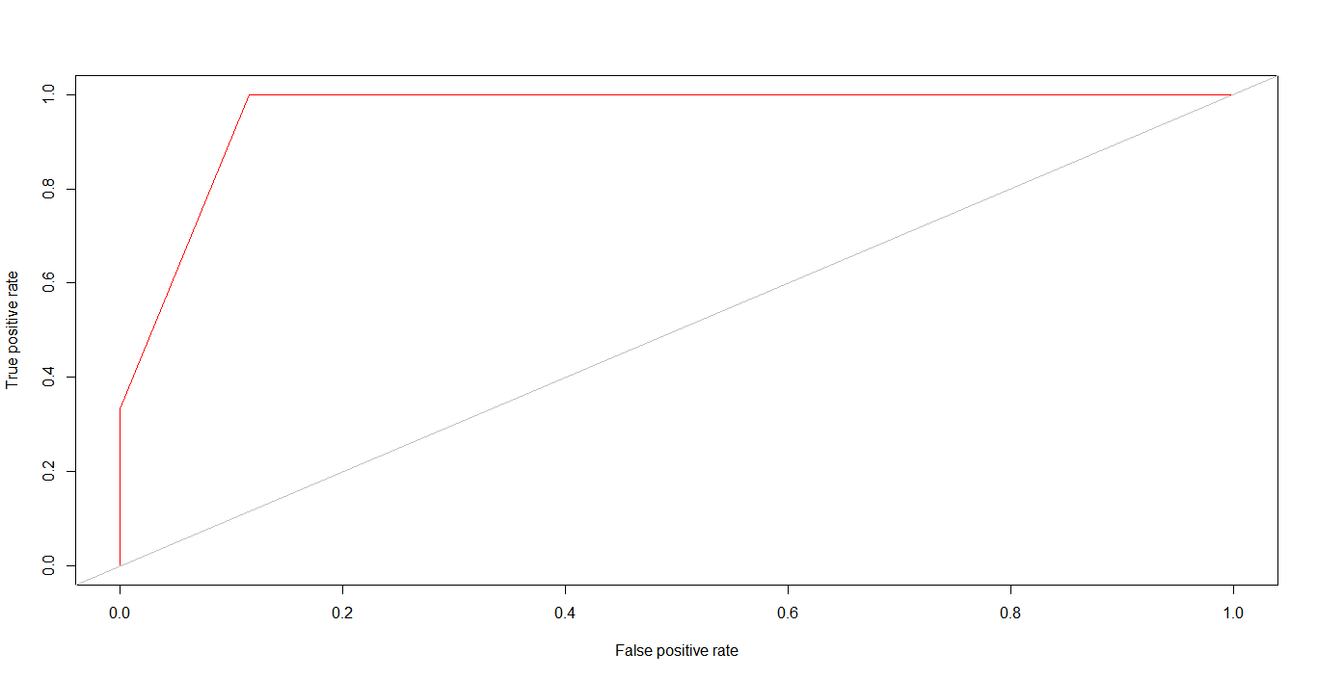
Validation of Model
The Validity of the model can be checked by ROC curve which is a curve between sensitivity and specificity.
Sensitivity= true positives/(true positive + false negative)
Specificity=true negatives/(true negative + false positives)
The area under the curve tells the accuracy of the model. Here it is 96.15% which is good enough for making predictions using this model.
Area under the curve: 0.96

Slide 11
Outcome of Scenario-1 – Predictive Analytics
employee code | Real.Status | predictions
8 | WORKING | WORKING
24 | WORKING | WORKING
96 | LEFT | WORKING
128 | WORKING | WORKING
129 | WORKING | WORKING
140 | WORKING | WORKING
142 | WORKING | WORKING
148 | WORKING | WORKING
171 | WORKING | WORKING
184 | WORKING | WORKING
203 | WORKING | WORKING
206 | LEFT | WORKING
215 | WORKING | WORKING
224 | WORKING | WORKING
258 | WORKING | WORKING
272 | LEFT | LEFT
281 | WORKING | WORKING
284 | WORKING | WORKING
290 | LEFT | LEFT
318 | LEFT | LEFT
320 | LEFT | LEFT
340 | WORKING | WORKING
341 | WORKING | WORKING
Model is used for prediction of test sample data to compare the actual results & accuracy.
Some of the predictions are shown in the image on right and detailed file is attached.
Result: Out of 62 employees, 26 (41%) employees left the company.
Our model accurately predicted working status for 59 employees, hence giving 95% accuracy.
So this model can be used to predict attrition for future employees by inputting the data.

Slide 12
Actionable Insights
Factors responsible for attrition are Number of companies worked, Satisfaction level and employer appreciation.
To decrease current attrition rate of 41% following actions should be taken.
Identification of Employee for appraisal (Quarterly/Yearly) and best performer award distribution on monthly/quarterly basis for motivation.
Roles and responsibilities to be properly to be specified.
Training for all employees at least once a month.(Technical/Soft Skill/ new technology)
Role change for the employees who are showing low satisfaction with current role.
Periodical surveys to understand the mental state(positive/negative/motivation level) of employees.

Slide 13
Use Case Scenario -2: Emp. Performance Analysis & its prediction
This model does performance analysis & predicts:
Which employee in the company have low satisfaction level than other and why.
Who are the best performers. Who are the employees who need technical training or any other
training such as soft skills, Management etc.
What policies should be made to improve retention rate of the employees.
Segmenting the people who needs improvement from their dedication and performance
perspective.
Identify the people who needs HR attention for retaining them within the organisation.

Slide 14
Scenario - 2
For a company, historical data of employees is available with variables as shown below and full data file is attached.
EMP. CODE | EMPLOYEE NAME | GENDER
AGE | QUALIFICATION | HIGHEST QUALIFICATION
DATE_OF CONFERMATION | DESIGNATION | GRADE
CURRENT CTC | WORKING STATUS | SATISFACTION LEVEL
NUMBER OF COMPAINES WORKED | PERCENT SALARY HIKE | TRAINING TIME LAST YEAR(In Hrs)
MARITAL STATUS | DATE OF BIRTH | TODAY'S DATE
EXPERIENCE OTHERS | EXPERIENCE IN ATAEIL | DATE_OF JOINING
DEPARTMENT | DIVISION | JOINING CTC
EMPLOYER APPRECIATION | JOB INVOLMENT | DISTANCE FROM HOME
YEAR SINCE LAST PROMOTION | WORKING HOURS 2017 | AVERAGE MONTHLY HOURS

Slide 15
Defour’s Analytics HR Model -Algorithm
K-means algorithm is used to make clusters based on Euclidian distance among
the variables.
This Defour algorithm creates clusters based on similar attributes.
Advance analytical tool (R) is used at the back end for designing this algorithm.
K- Means Clustering
Euclidian distance among observations forming clusters.
Advanced Analytics Tool
Analytics Dashboard

Slide 16
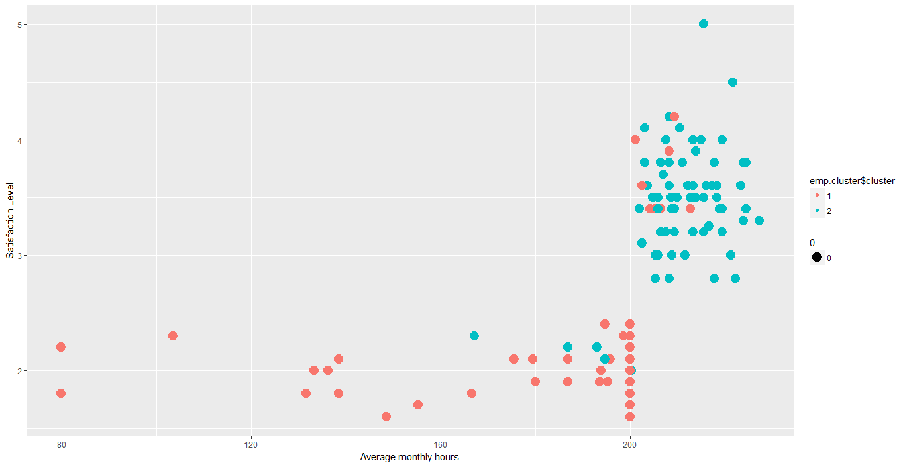
Actionable Insights
Employees working more than 200 hours are typically highly satisfied
Analysis outcome :
Cluster of employees working more than 200 hours are typically highly satisfied.
Cluster of employees working less than 200 hours powered to be less satisfied.
Immediate Actionable Insights :
Put a check on employees who are not working more than stipulated hours.
Counselling is required for employees having low satisfaction level to investigate the root cause of their low satisfaction.
Employees working less than 200 hours are less satisfied

Slide 17
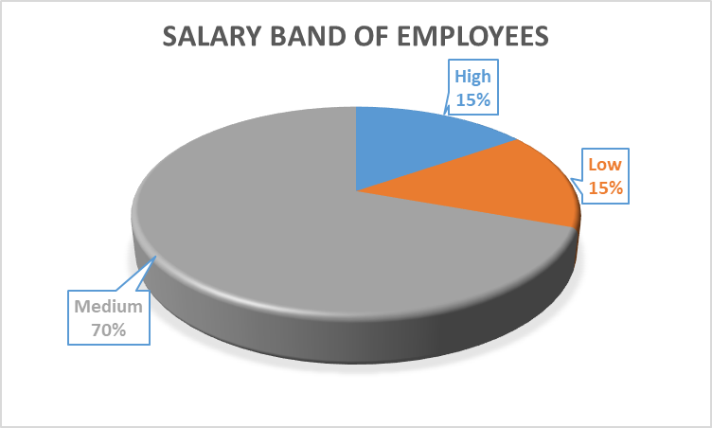
Deep Dive – Cluster of High Satisfied Employees
Out of those 72 employees,
63 employees are more than 2 years old in the company.
This means old employees are more dedicated and satisfied with the company.
56 employees most of them are in Low and medium salary band.
Means Satisfaction has no correlation with Salary.
61 are from only three divisions i.e. Ball Valve, HO Pune and Indarpur division.

Slide 18
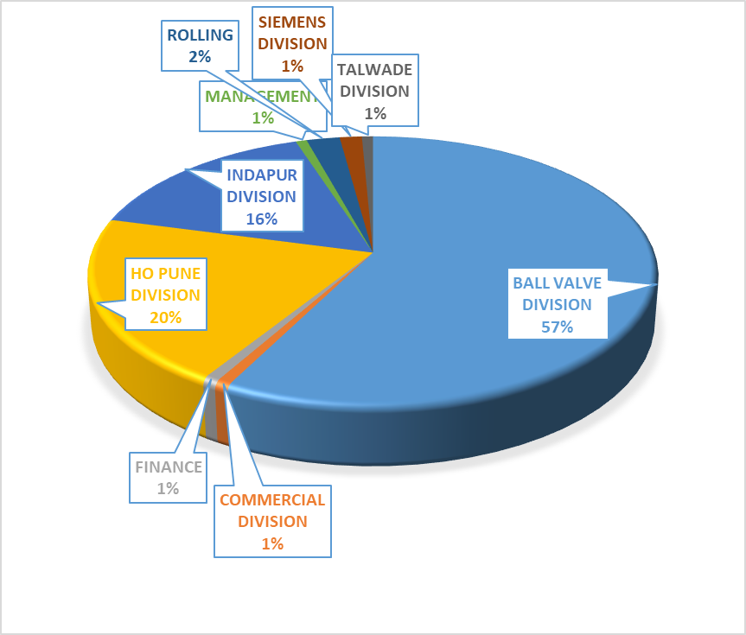
Deep Dive – Cluster of Low Satisfied Employees
57% of these employees are from Ball Valve Division.
Key reason of their dis-satisfaction is work over load and distribution of task.
Relook the KPIs, skill mapping & opportunity for better career prospects etc.
To mitigate the risk of their attrition, HR must bring various initiatives like training workshops, counselling, role change etc.

Slide 19
Actionable Insights
Company goal is not clearly communicated to employee creating a gap and affecting satisfaction level. Hence there should be a proper channel of communication for business goal followed with any leadership.
Trimming rewards and recognition are expected to accomplish the feeling of personal accomplishment.
Company growth road map should be transparent to people and clear picture of growth unknown.
Every successful milestone should be shared proudly to employees to retain the motivation.
Customer centric approach is observed strongly.
Company is able to maintain to upkeep the high standard of cultural diversity and also there is not differentiation among employees.

Slide 20
Way Forward
Decisions should be based on data driven approach rather than perspective – Indicating adjustments in if needed in HR processes like timely corrections in various HR processes like PMS, training initiatives, recruitment etc.
Sales, Technical department employees need to be addressed by HR and use following practices.
Assess the situation thoroughly
Privacy is key
It takes time
Keep records
Selecting 10%ile people from high and low performing clusters. Making groups of two employees each having same role, experience and education background from each cluster and doing rationalization (load sharing).
It will reduce the risk of attrition, increase efficiency without any additional cost to the company.

Slide 21
Defour Offerings – 1st Approach
❑ Develop Algorithm / different use case scenarios like;
Predicting attrition on month on month basis,
Detection of satisfaction with respect to compensation
Identifying potential candidates for upgradation of skill / technical /functional knowledge
Role related anomaly with peers
Stagnancy
Self service analytics utilizing appropriate models*
Model management including data handling, error handling, tuning, adjustment based on different scenarios
Training of M&M team, hand holding for applying analytics appropriately across different business objectives
Providing an appropriate analytics tool for self service analytics
*Models are IP of Defour

Slide 22
THANK YOU
Copyright © 2016 Defour Analytics Pvt. Ltd

